Slide 1
Time Scaling of Continuous-Time Signals
Speed up or slow down a signal • Multiply the time in the argument by a constant

Slide 2
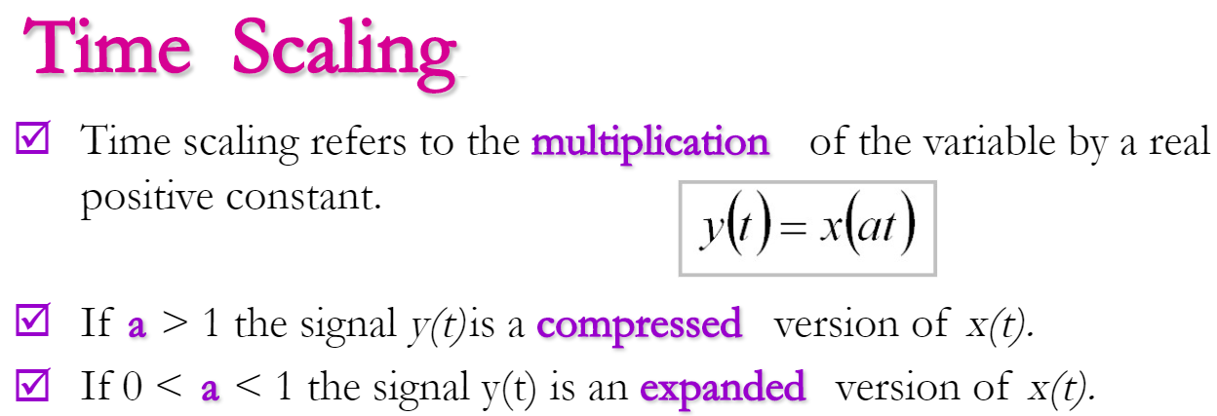
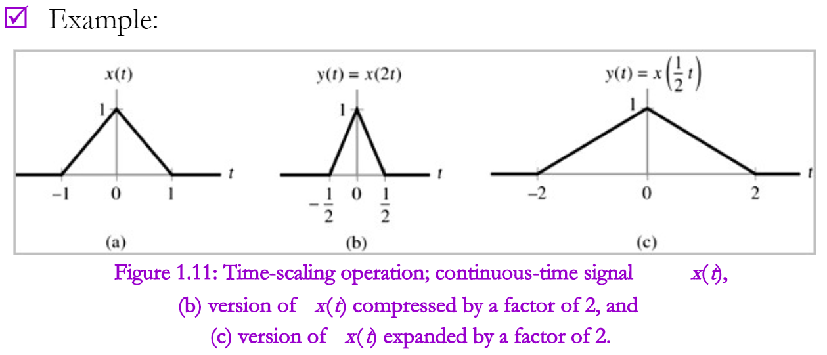
Speed up or slow down a signal.
Multiply the time in the argument by a constant

Slide 3
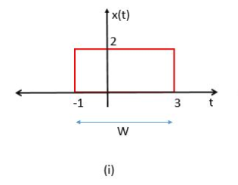
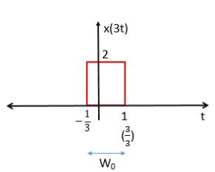

Q: Find x(3t)
$$3t=−1$$
$$t=−\frac{1}{3}$$
$$And$$
$$3t=3$$
$$t=\frac{3}{3}=1$$
Time Compression

Slide 4
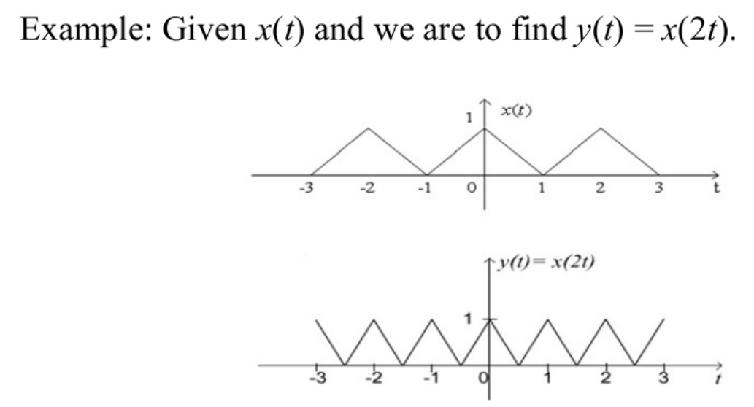
Time Scaling Compression

Slide 5
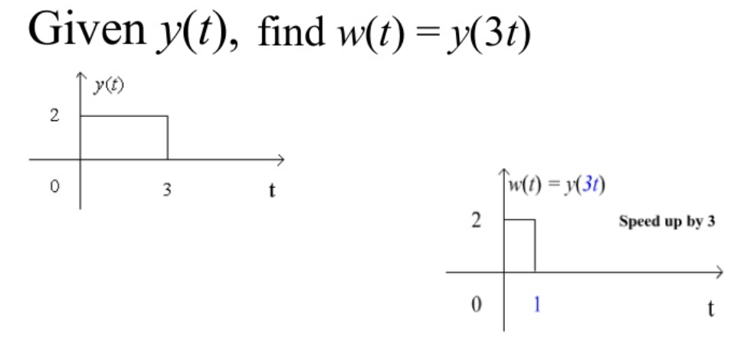
Time Scaling Expansion

Slide 6
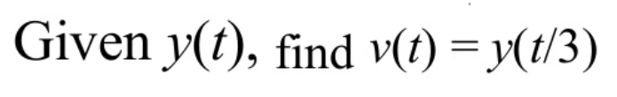
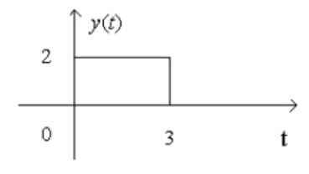
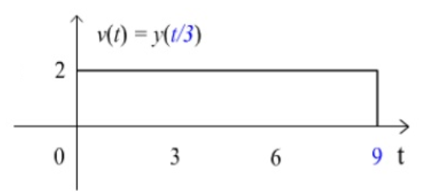

$$\frac{t}{3}=0$$
$$t=0$$
$$And$$
$$\frac{t}{3}=3$$
$$t=9$$

Slide 7
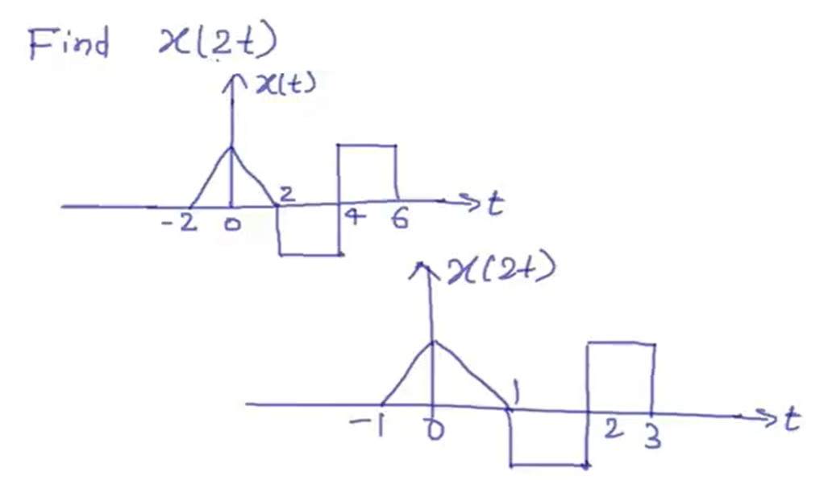
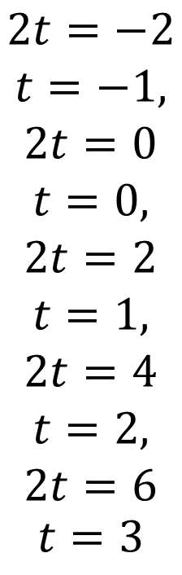
$$2t=−2$$
$$t=−1,$$
$$2t=0$$
$$t=0,$$
$$2t=2$$
$$t=1,$$
$$2t=4$$
$$t=2,$$
$$2t=6$$
$$t=3$$
Solution

Slide 8
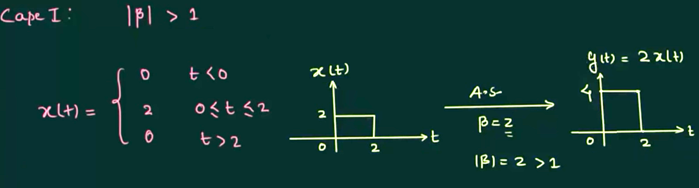
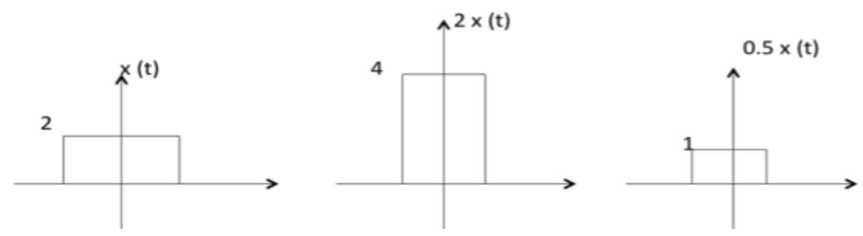
Amplitude Scaling of Continuous-Time Signals
Amplification
Multiply the entire signal by a constant value
OR

Slide 9
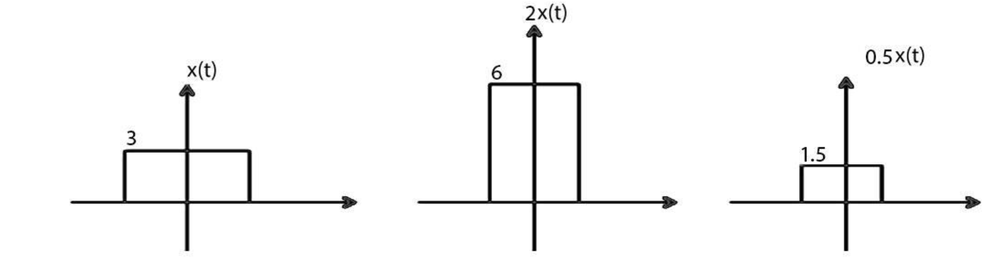
Amplitude Scaling of Continuous-Time Signals
Amplification Reduction

Slide 10
Shifting of Continuous-Time Signals
Shifting means shift the signal position to left or right is called Shifting.
Shifting is the two types:
Time Shifting
Amplitude Shifting

Slide 11
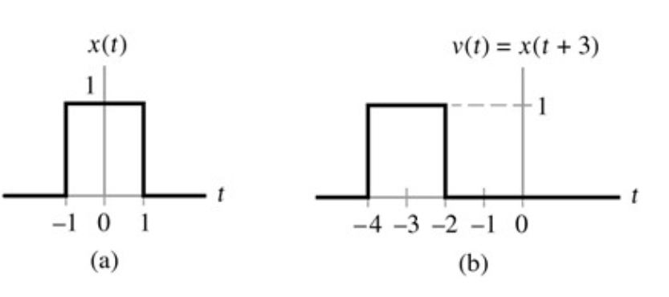
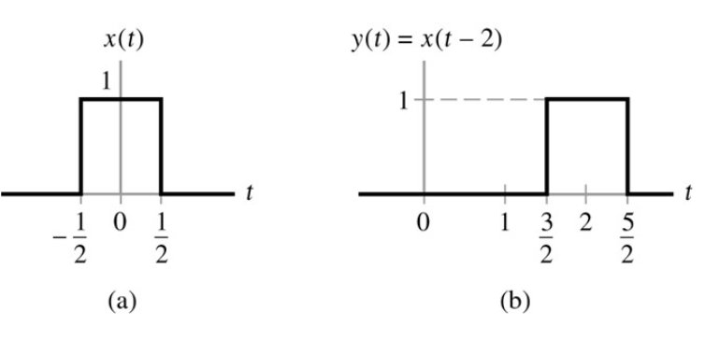
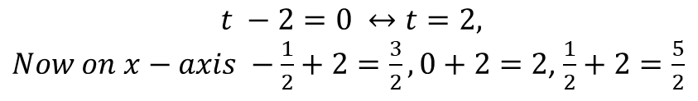
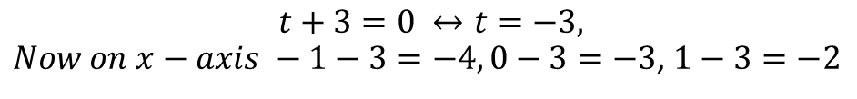
Time Shifting of Continuous-Time Signals
Left Shifting OR
Time Advance
Right Shifting OR
Time Delay
$$t −2=0 ↔t=2,$$
$Now on x−axis −\frac{1}{2}+2=\frac{3}{2}, 0+2=2$, $\frac{1}{2}+2=\frac{5}{2}$
$$t+3=0 ↔t=−3,$$
$Now on x−axis −1−3=−4, 0−3=−3$, $1−3=−2$

Slide 12
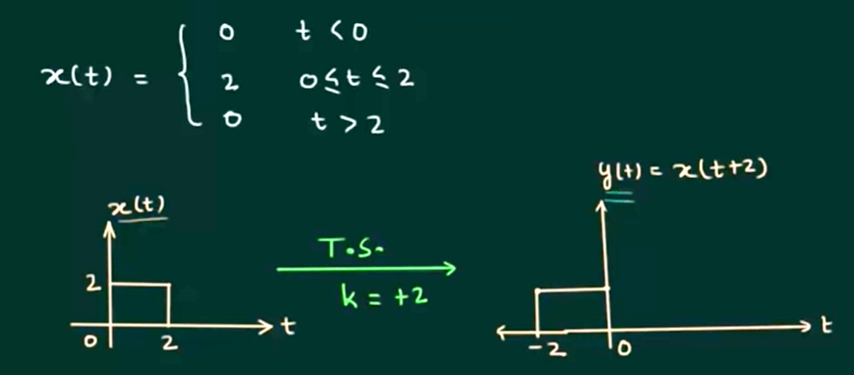
Time Shifting of Continuous-Time Signals

Slide 13
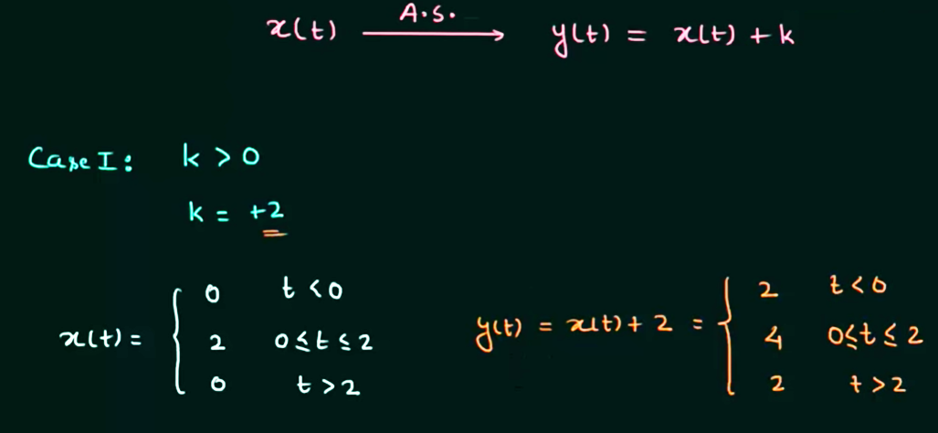
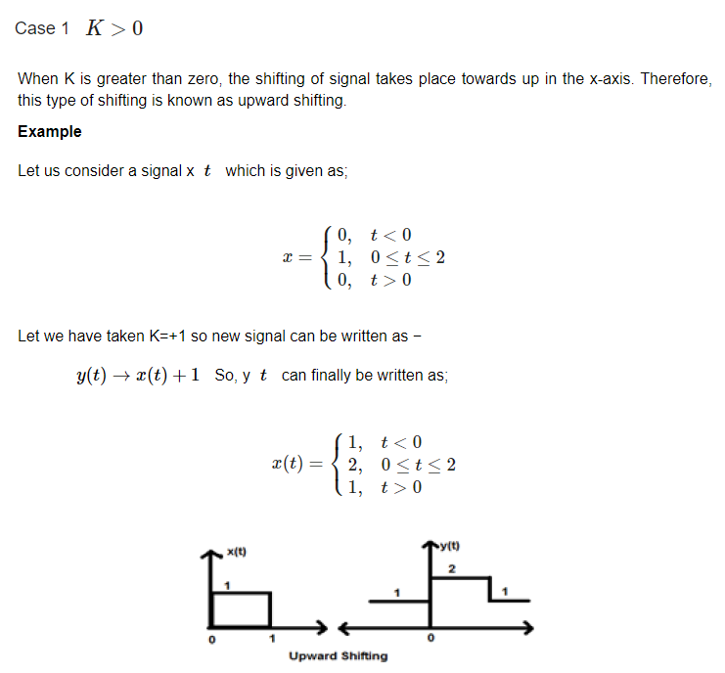
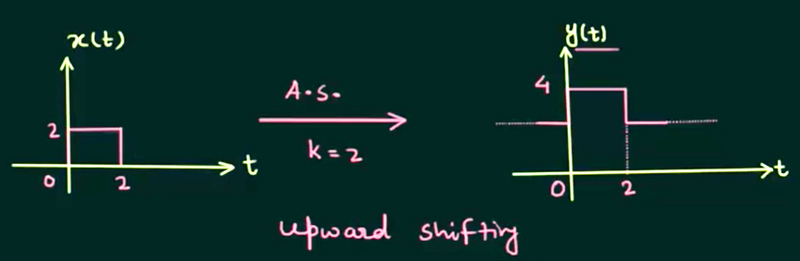
Amplitude Shifting of Continuous-Time Signals

Slide 14
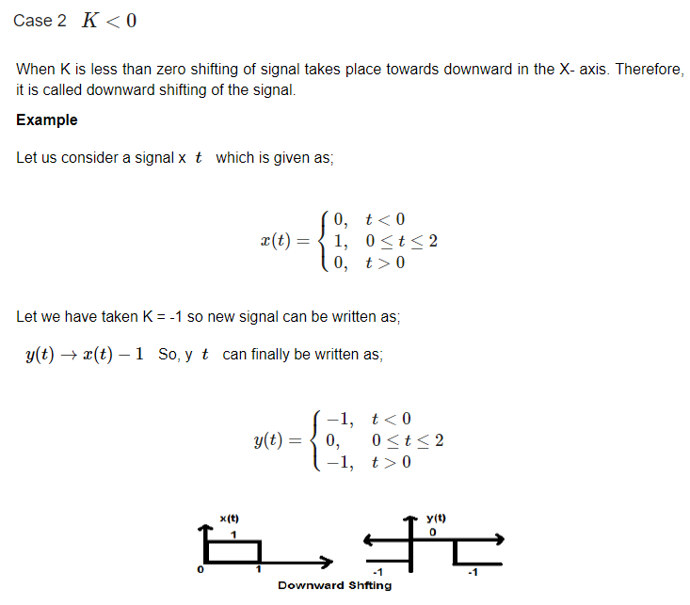

Slide 15
Reversal of Continuous-Time Signals
Whenever the time in a signal gets multiplied by -1, the signal gets reversed.
It produces its mirror image about Y or X-axis. This is known as Reversal of the signal.
Reversal can be classified into two types based on the condition whether the time or the amplitude of the signal is multiplied by -1

Slide 16
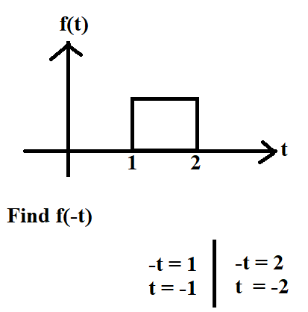
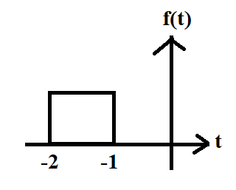
Reversal of Continuous-Time Signals Case-1: Time Reversal

